Slide 1
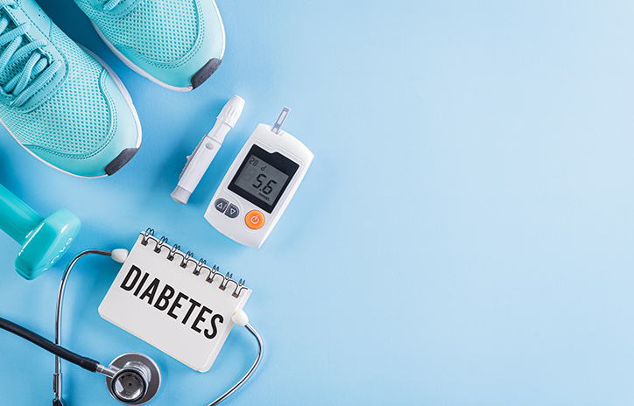
Predicting diabetes:
A Machine Learning Perspective
Andy Jinghui Lou
Brenda Jingrui Zhang
Eric Qixuan Li
Ethan Yiteng Han
Joshua Jiahao Wang

Slide 2

CONTENTS
01
Background & Goal
02
About the Data
03
About the Method
04
Results
05
Conclusion & Future

Slide 3
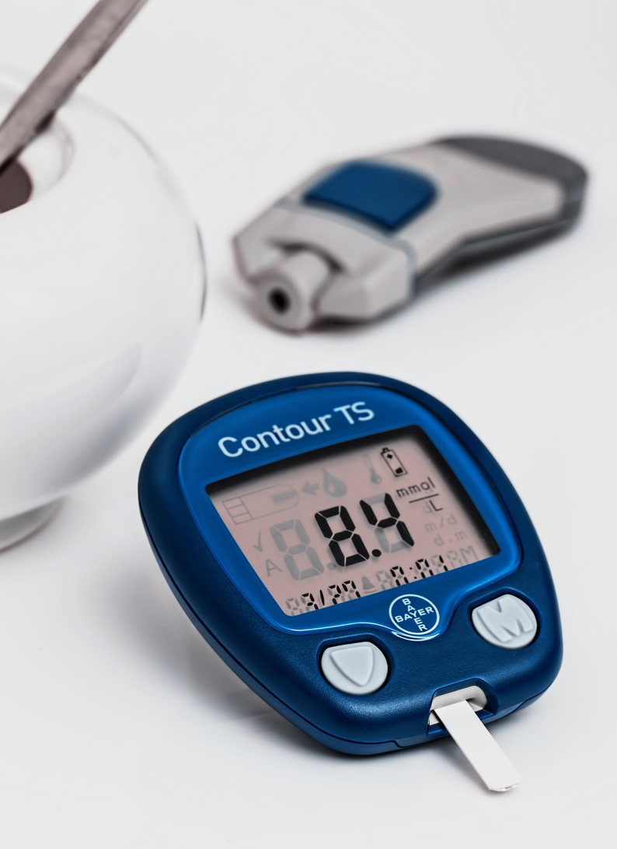

01
Background and Goal
Predicting Diabetes:A Machine Learning Perspective

Slide 4
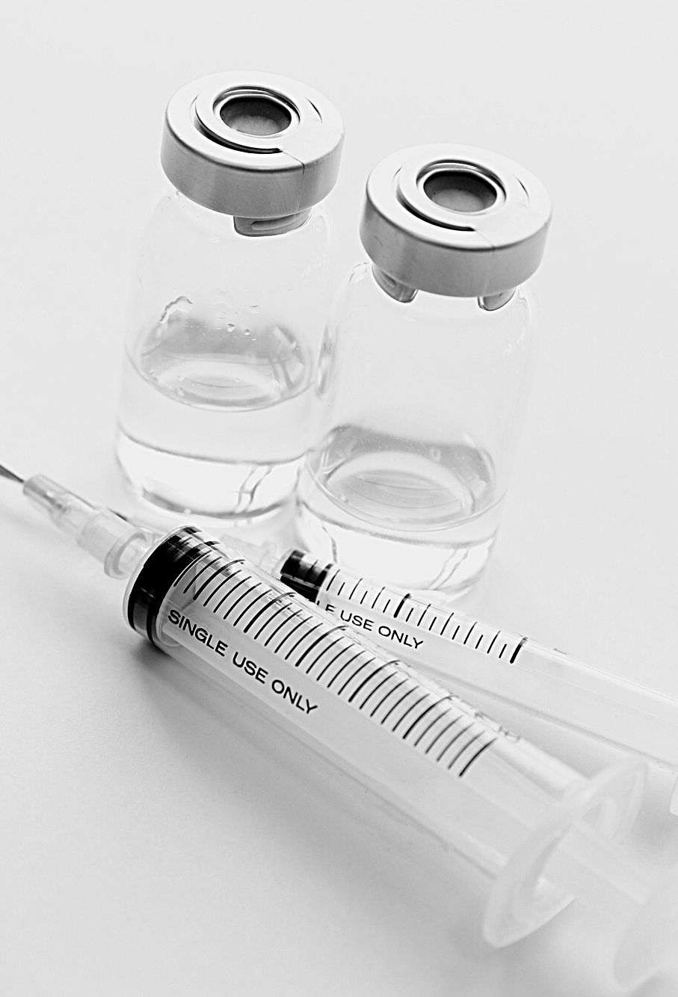
Diabetes
Death
Complications
High Morbidity
Background

Slide 5
Our Goal
Our machine learning project aims to assess the likelihood of a woman developing diabetes based on a set of her health data. By utilizing Kaggle's diabetes dataset and applying machine learning algorithms like Naive Bayes, Support Vector Machine (SVM), and Random Forest, we intend to create a predictive model.
This model will take in specific health parameters of a woman as input and return the probability of her developing diabetes. The goal is to use these information to aid in individuals’ early detection and preventive measures.
Machine learning in medical area
Southern et al. (2010)
Use administrative databases to identify diabetes patients
Jayanthi et al. (2017)
Mention models for diabetes prediction
Potential of machine learning and data mining techniques
French national health insurance information system (SNDS)(2019)
Specificities and negative predictive value over 99%

Slide 6
02
About the Data
Predicting Diabetes:A Machine Learning Perspective

Slide 7

About Datasets
This dataset is originally from the National Institute of Diabetes and Digestive and Kidney Diseases. The objective of the dataset is to diagnostically predict whether a patient has diabetes, based on certain diagnostic measurements included in the dataset. Several constraints were placed on the selection of these instances from a larger database. In particular, allapatients here are females at least 21 years old of Pima* Indian heritage.
https://www.kaggle.com/datasets/akshaydattatraykhare/diabetes-dataset
https://www.britannica.com/topic/Pima-people

Slide 8
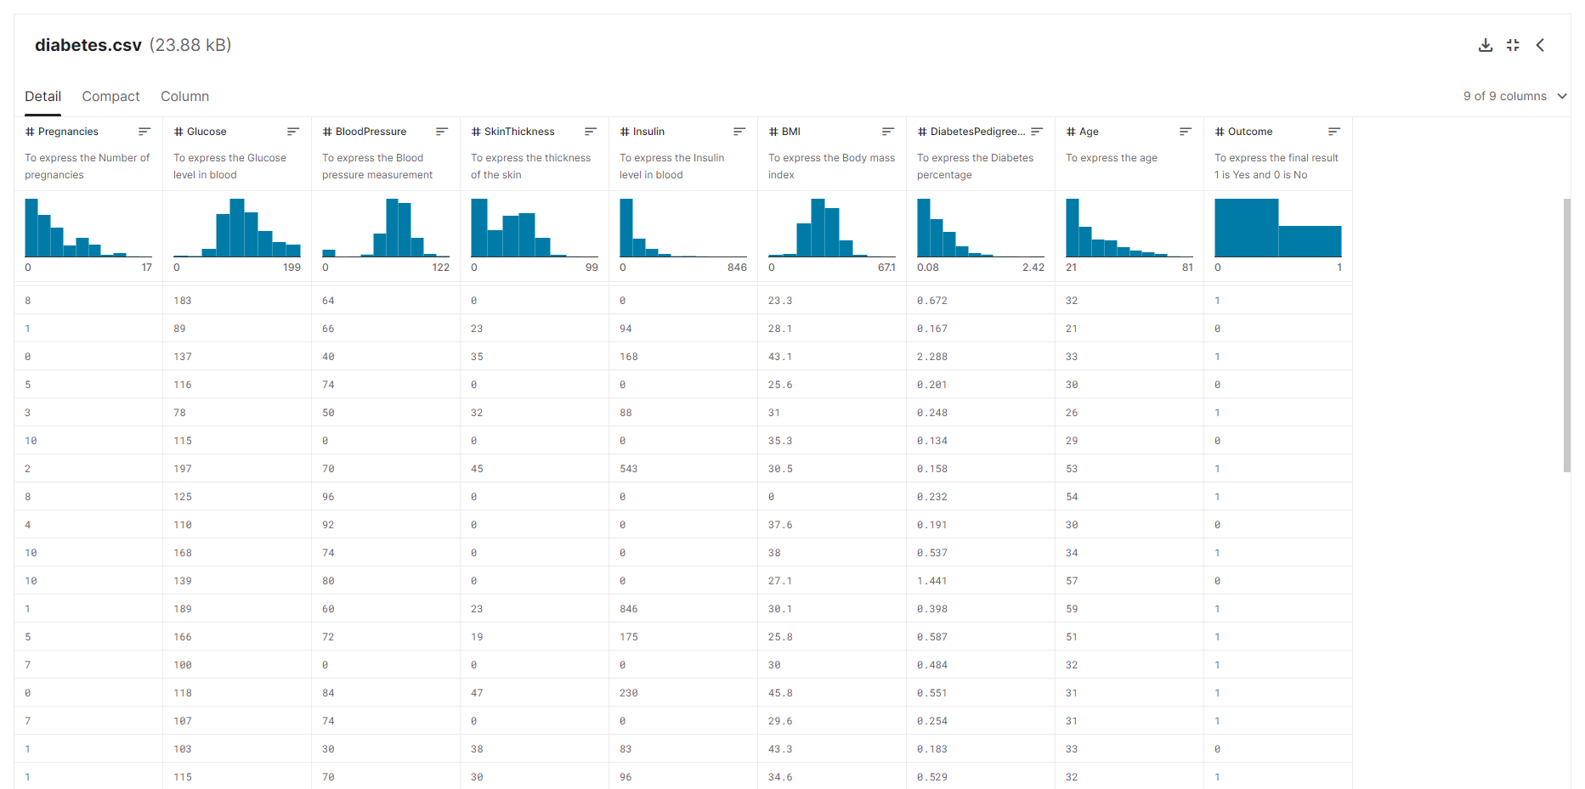

Slide 9
03
About the Method
Predicting Diabetes:A Machine Learning Perspective

Slide 10

Methods
Load the datasets
Fix the datasets
Visualize the datasets to see each column’s distribution
Splitting the data
Apply datasets to three different machine learning algorithms
Naive Bayes
Support Vector Machine
Random Forest
Tuning Parameters
Compare those models after tuned
Create an easy application

Slide 11
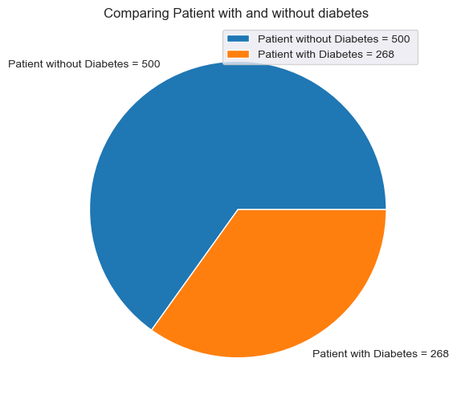
Load the datasets
Total: 768 sets of data
Without Diabetes:500
With Diabetes:268

Slide 12
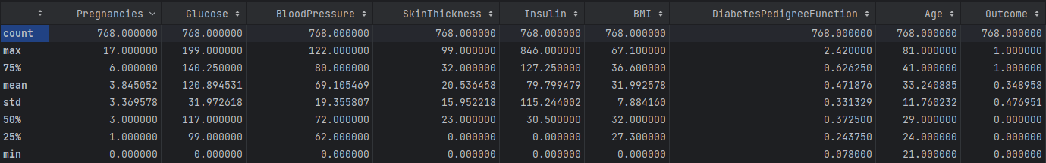
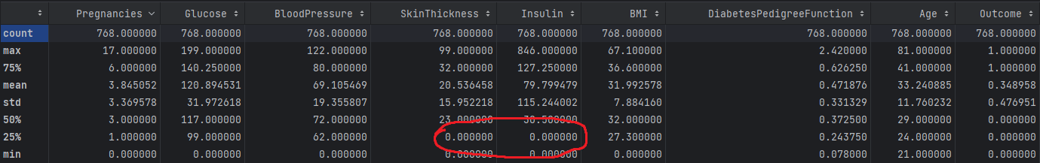
Fix the datasets

Slide 13
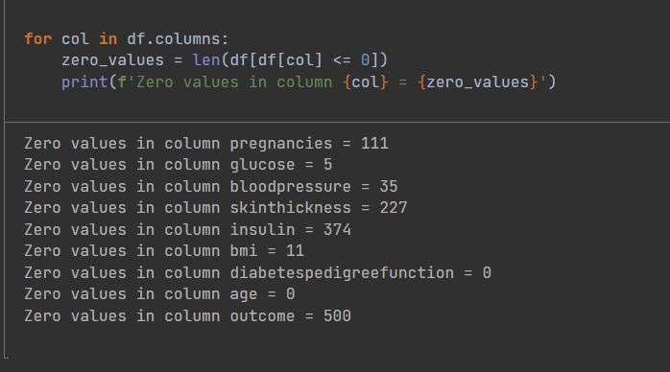
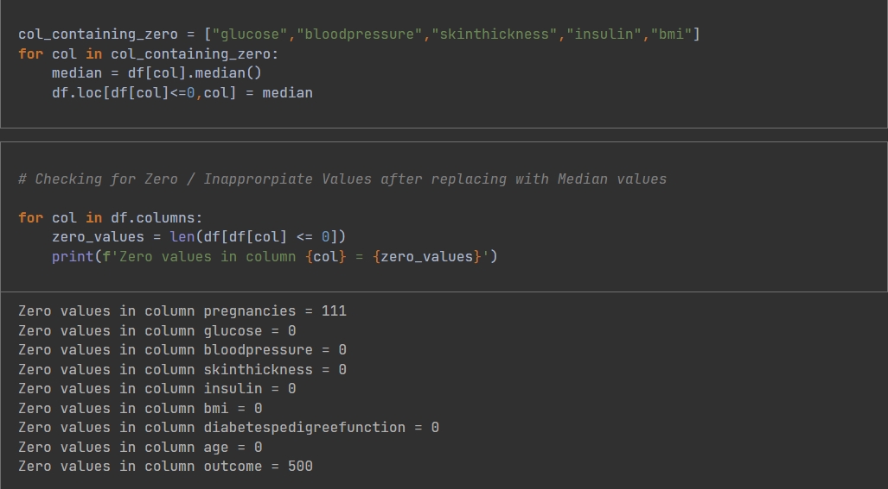
Fix the datasets
Zero values in column glucose = 5
Zero values in column bloodpressure = 35
Zero values in column skinthickness = 227
Zero values in column insulin = 374
Zero values in column bmi = 11

Slide 14
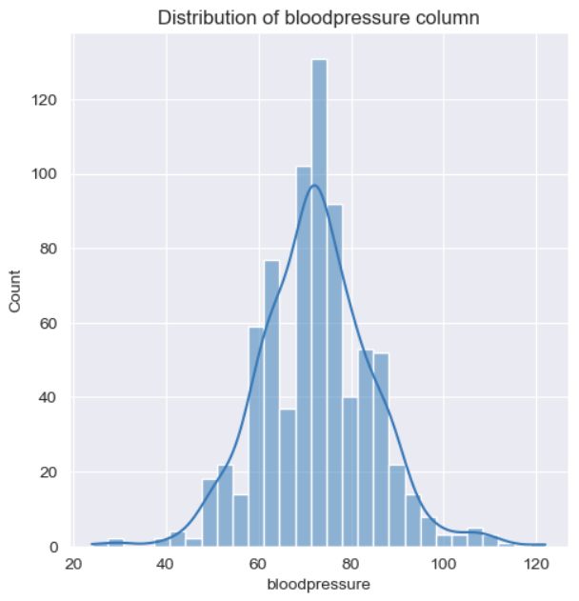
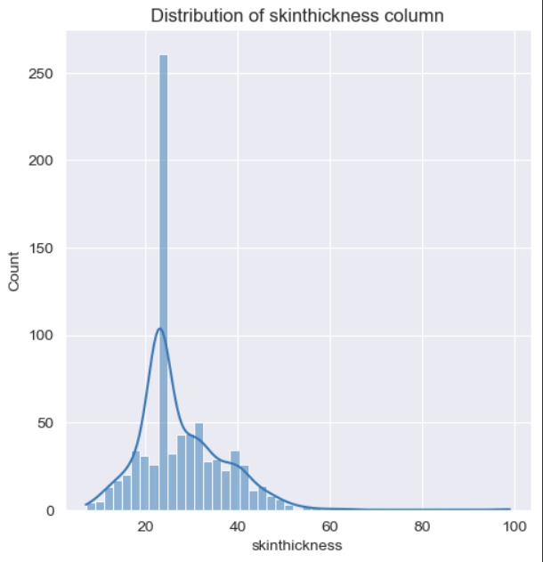
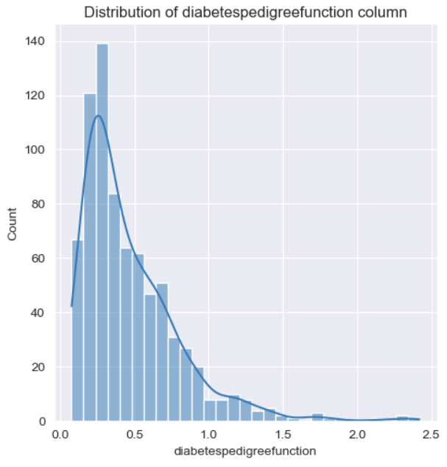
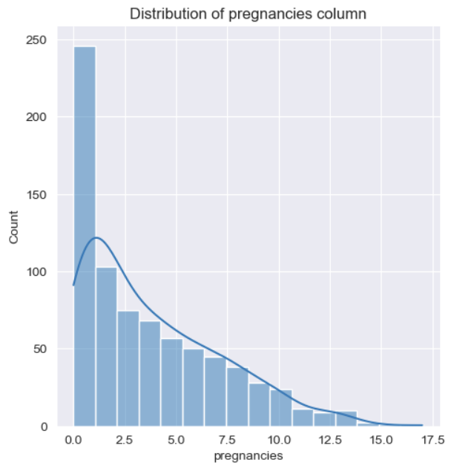
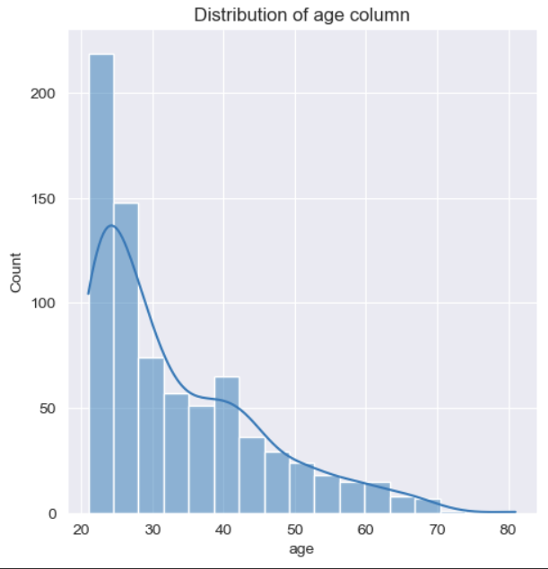
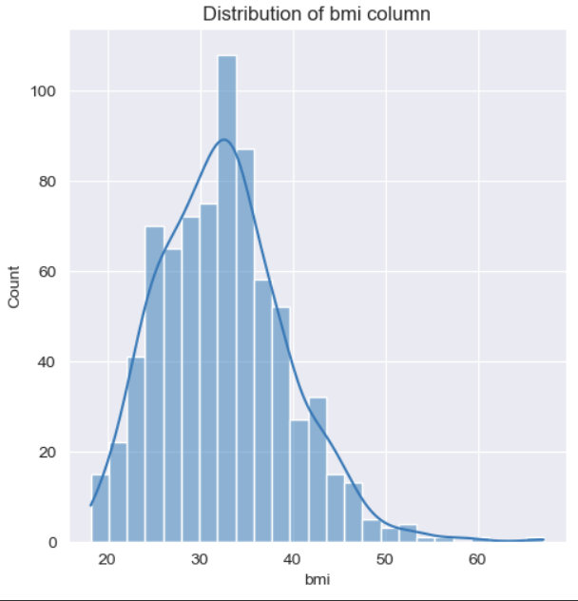
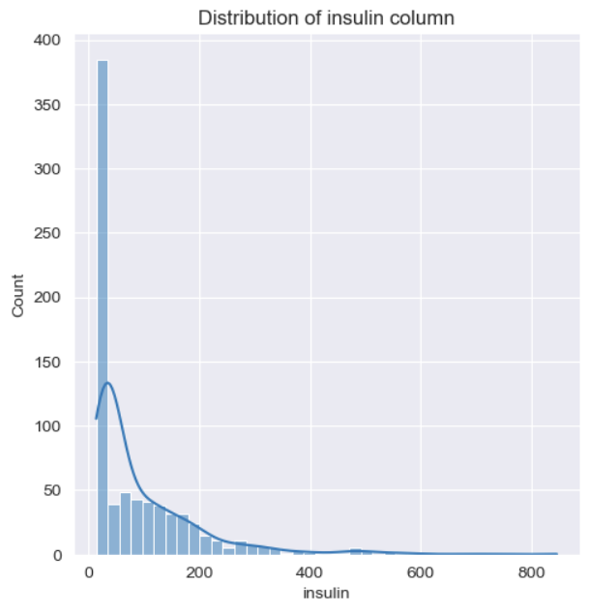
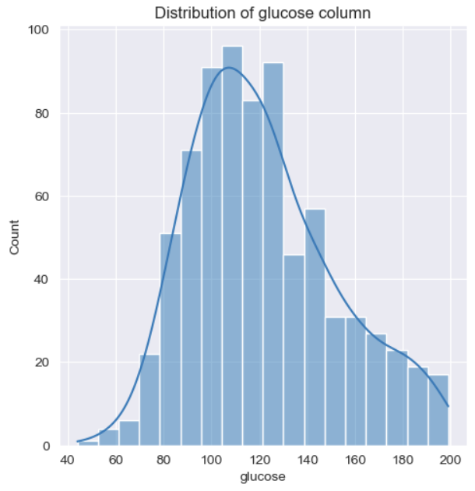
Visualize the datasets
Visualize the datasets to see each column’s distribution

Slide 15
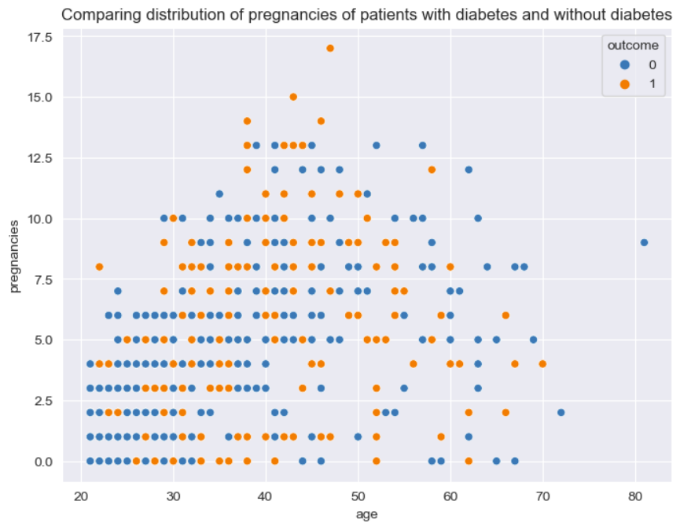
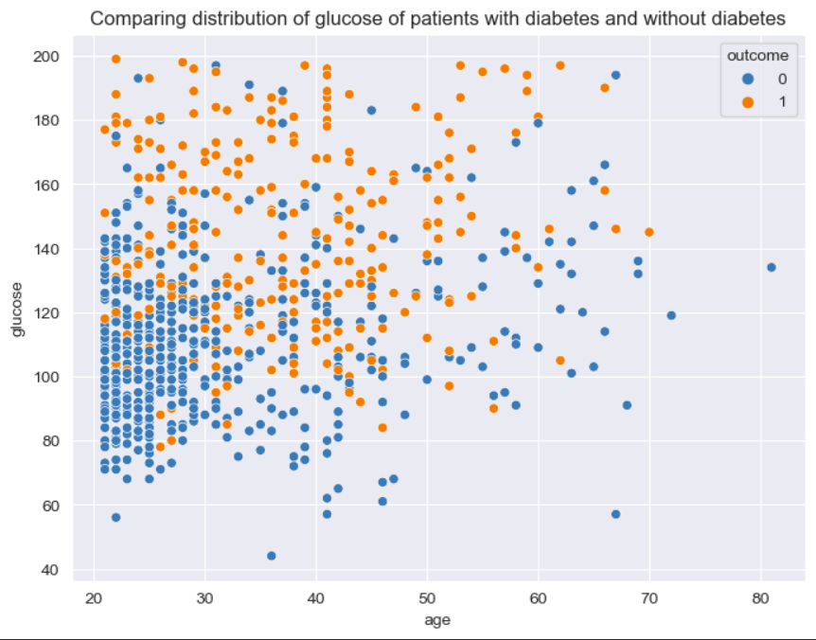
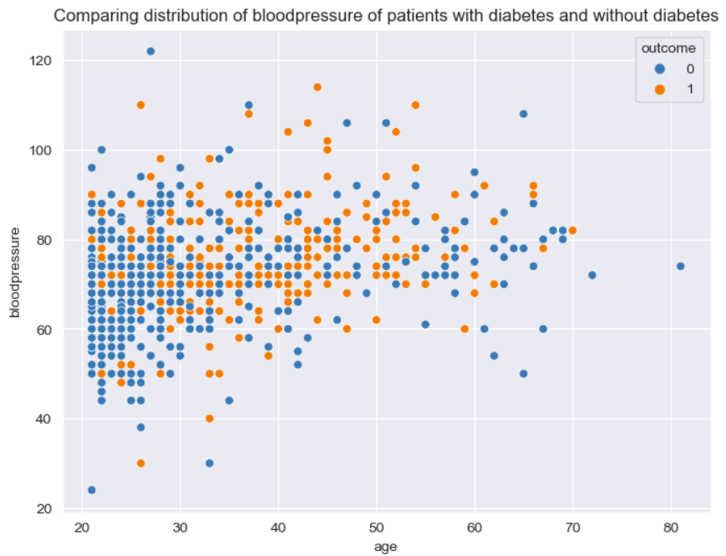
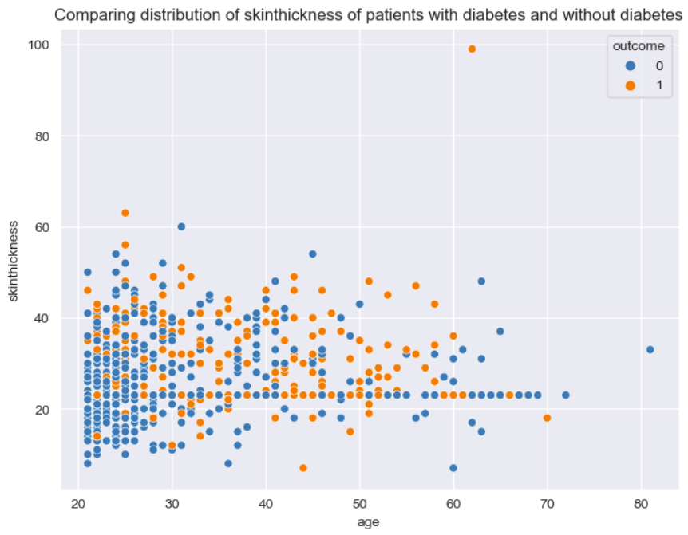
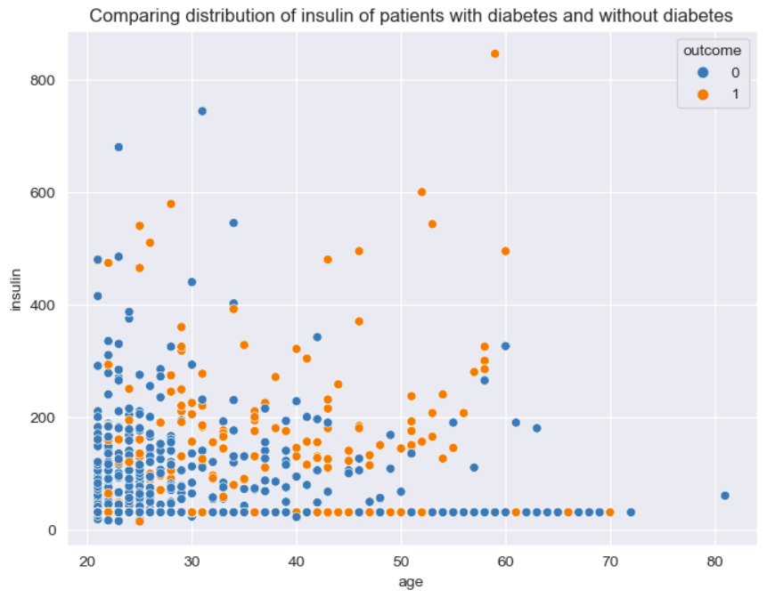
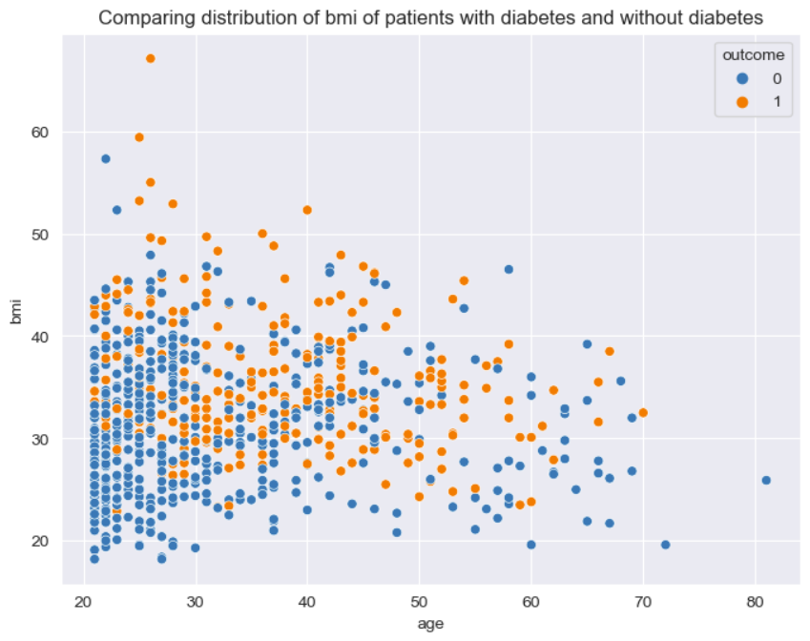
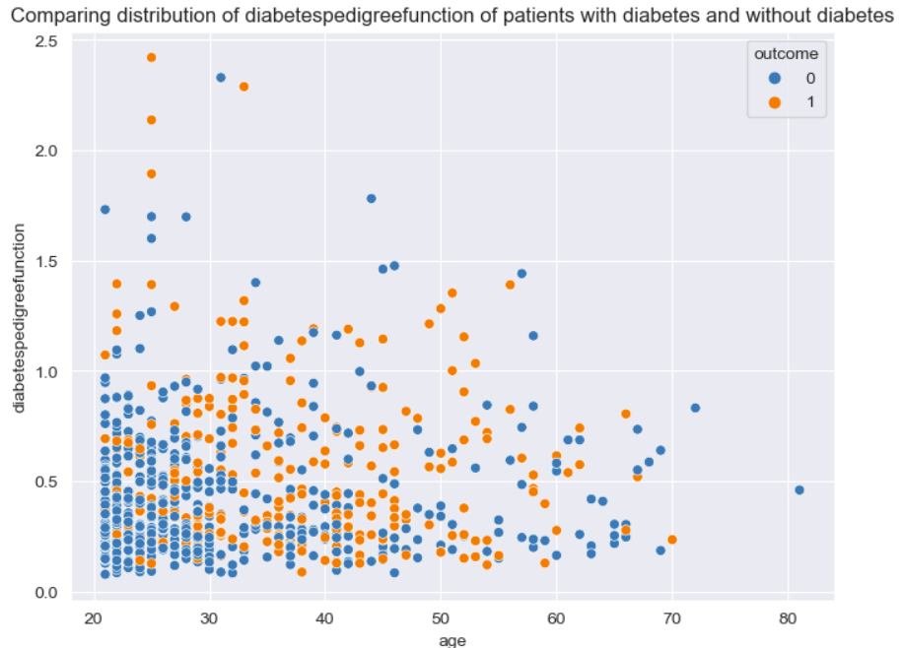
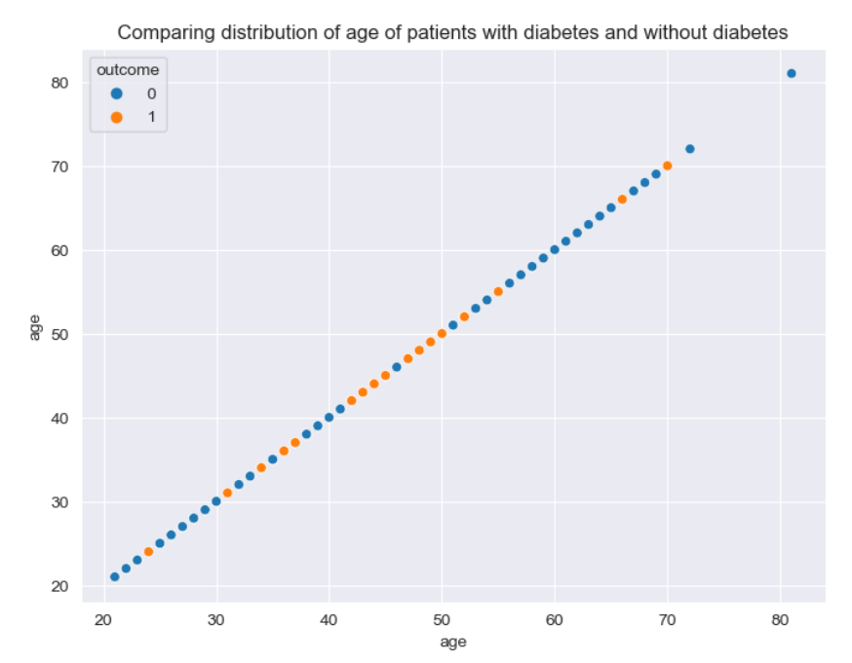
Visualize the datasets
Compare each index of patients with diabetes and without diabetes.

Slide 16
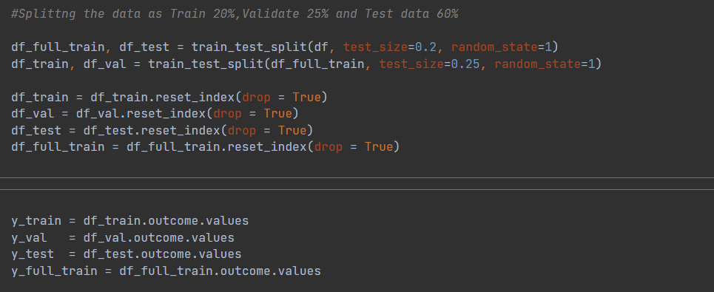
Splitting the data
Validation sets are for the future parameter tuning in this case.
20% train, 20% validation, 60% test data

Slide 17
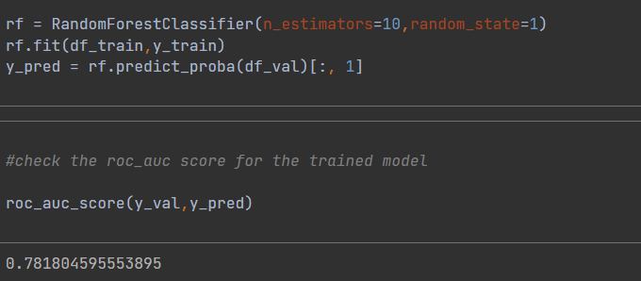
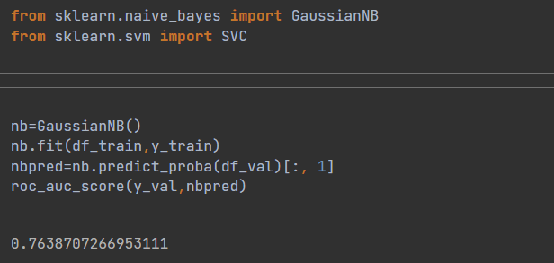
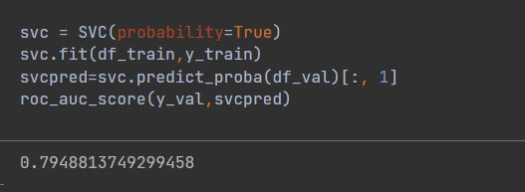
Apply datasets to three different machine learning algorithms
Navie bayes
Support Vector Machine
Random forest
Print out three basic accuracy on training data
RF：0.781804595553895
SVM：0.7948813749299458
NB：0.7638707266953111

Slide 18
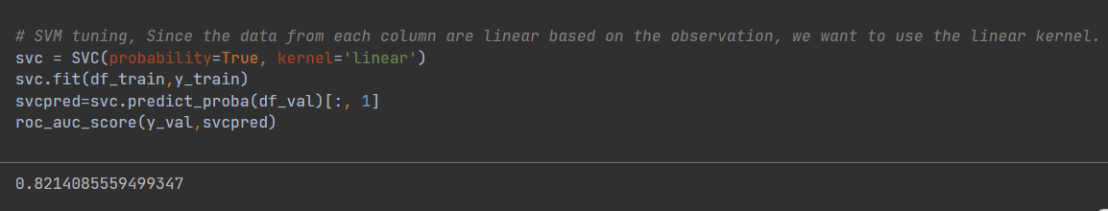
.
Tuning Parameters
Navie Bayes: We don’t need to because it doesn’t require a lot parameter tuning to use this model
SVM: in this case, change the kernel to “linear” will improve the model, because the datasets we have very linear and consistence
Training data accuracy of SVM: 0.7949
0.8214

Slide 19
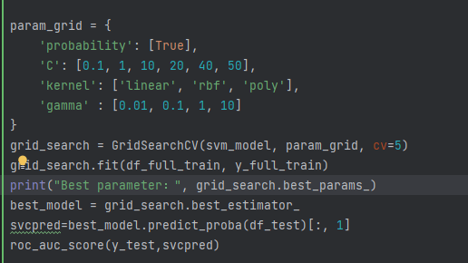
Further tuning
Adjust gamma to 0.01 and C to 40 that we find from GridSearchCV
Training data accuracy of SVM: 0.8214
0.8290

Slide 20
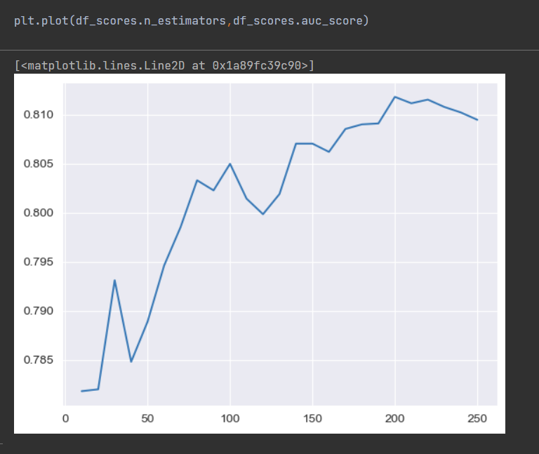
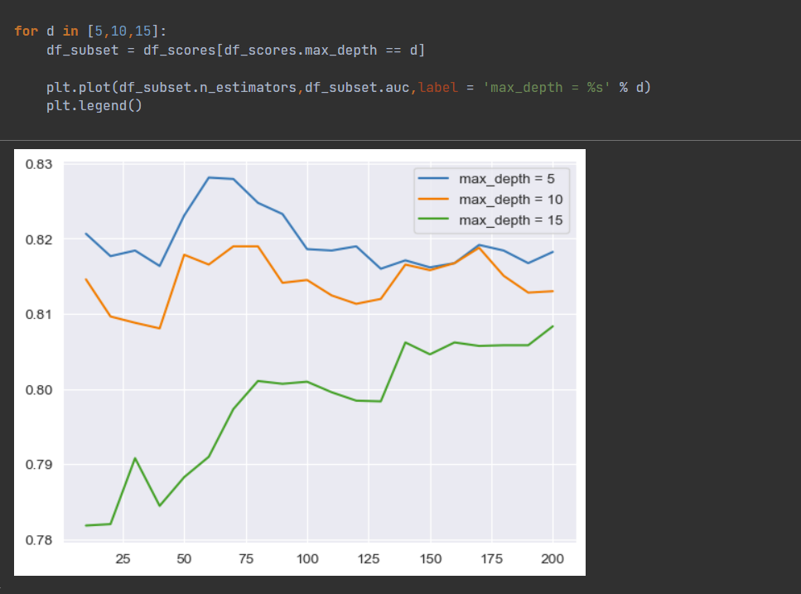
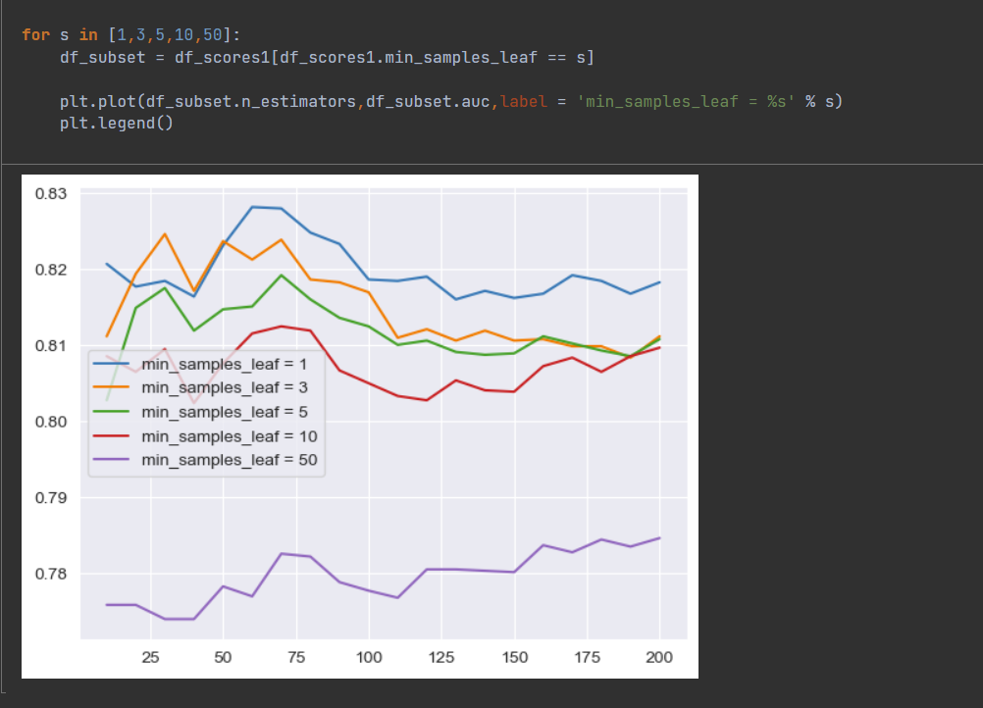
c. Random Forest

Slide 21
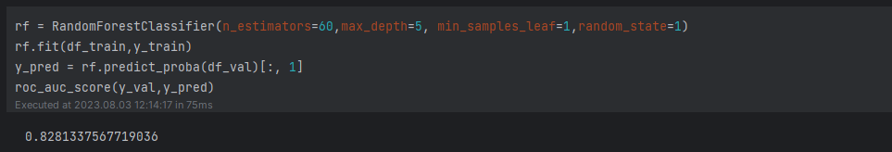
In this case, we will choose n_estimators=60, max_depth=5, min_sample_leaf=1
Training data accuracy of RF: 0.7818
0.8281

Slide 22
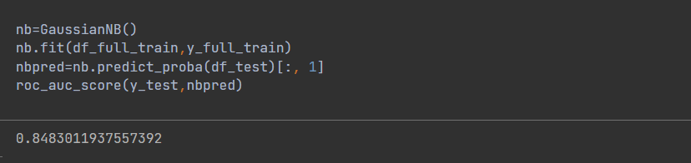
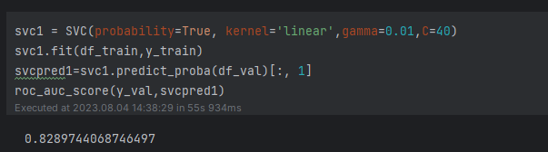
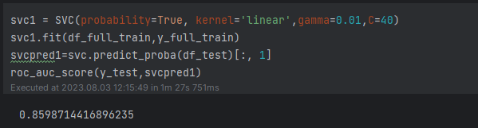
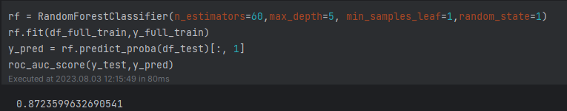
Compare those models after tuned
Training Data Accuracy
Test Data Accuracy
NB
SVM
RF

Slide 23
04
Result
Predicting Diabetes:A Machine Learning Perspective

Slide 24
Result
 | NB | SVM | RF
Training Data Accuracy(Before tuning) | 0.7639 | 0.7949 | 0.7818
Training Data Accuracy | 0.7639 | 0.8290 | 0.8281
Test Data Accuracy | 0.8483 | 0.8599 | 0.8724
Comparing test data accuracies, we find out the RF has the highest accuracy based on the diabetes datasets.

Slide 25
Create an easy application
Flask
A lightweight web application framework
Easy to use
Various tools and functions
Wide range of applications

Slide 26
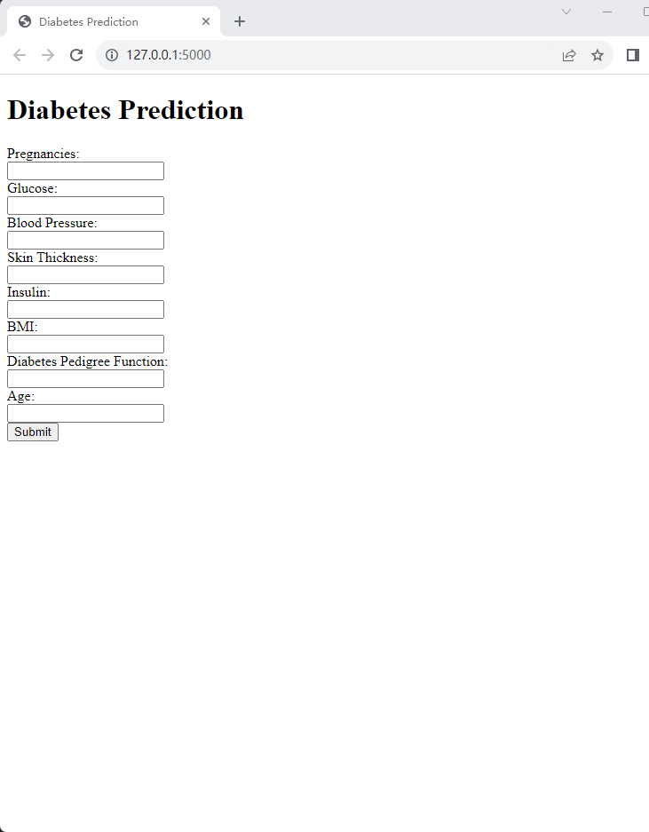
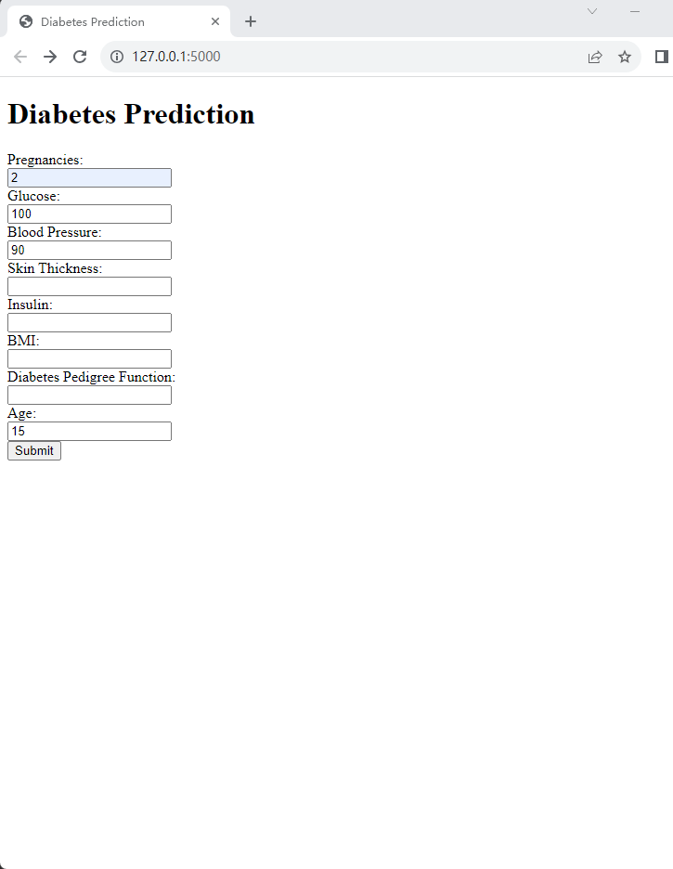


Slide 27
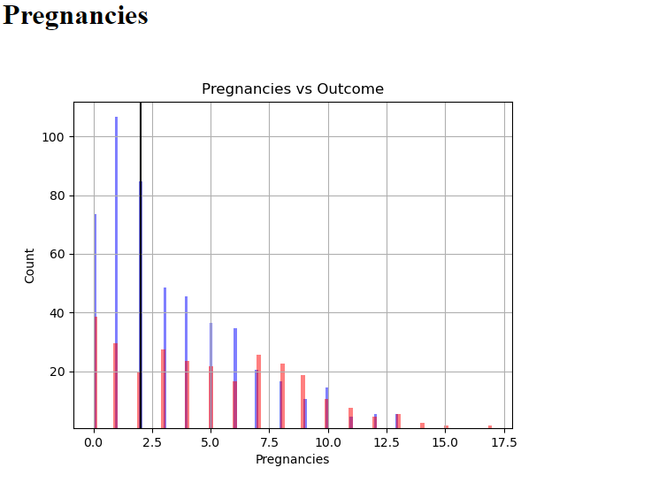
Example chart:
The probability of the patient having diabetes is xx.xx%. in this case, the number is 13.41.

Slide 28
05
Conclusion and Future
Predicting Diabetes:A Machine Learning Perspective

Slide 29




Conclusion and Future
Through unsupervised learning methods SVM, NB, and RF, we have developed a model for predicting diabetes among women based on the diabetes dataset from Kaggle. This model has shown good performance, achieving an accuracy of approximately 87.2% when applied to Random Forest. It enables individuals to assess their likelihood of developing diabetes and encourages timely precautionary measures.
Optimize Flask
Providing information and specific advice
Update models
Use easily available data
Reduce Diabetes
To be Continue……
Future work

Slide 30

MACHINE LEARNING
THANKS FOR WATCHING
2023/08/05

